Slide 1


Slide 2


Slide 3
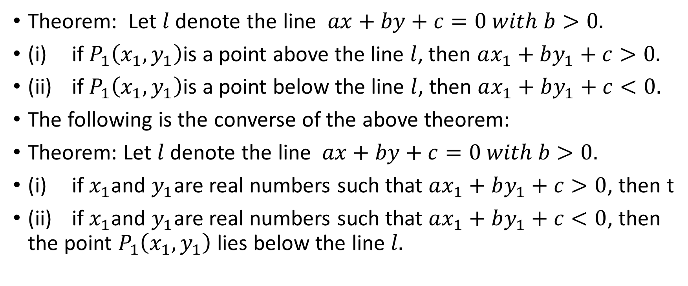
POSITION OF A POINT WITH RESPECT TO A GIVEN STRAIGHT LINE
Theorem: Let $l$ denote the line $ax+by+c=0 with b>0.$
(i) if $P_{1}\left(x_{1},y_{1}\right)$is a point above the line $l$, then $ax_{1}+by_{1}+c>0.$
(ii) if $P_{1}\left(x_{1},y_{1}\right)$is a point below the line $l$, then $ax_{1}+by_{1}+c<0.$
The following is the converse of the above theorem:
Theorem: Let $l$ denote the line $ax+by+c=0 with b>0.$
(i) if $x_{1}$and $y_{1}$are real numbers such that $ax_{1}+by_{1}+c>0$, then t
(ii) if $x_{1}$and $y_{1}$are real numbers such that $ax_{1}+by_{1}+c<0$, then the point $P_{1}\left(x_{1},y_{1}\right)$ lies below the line $l.$

Slide 4
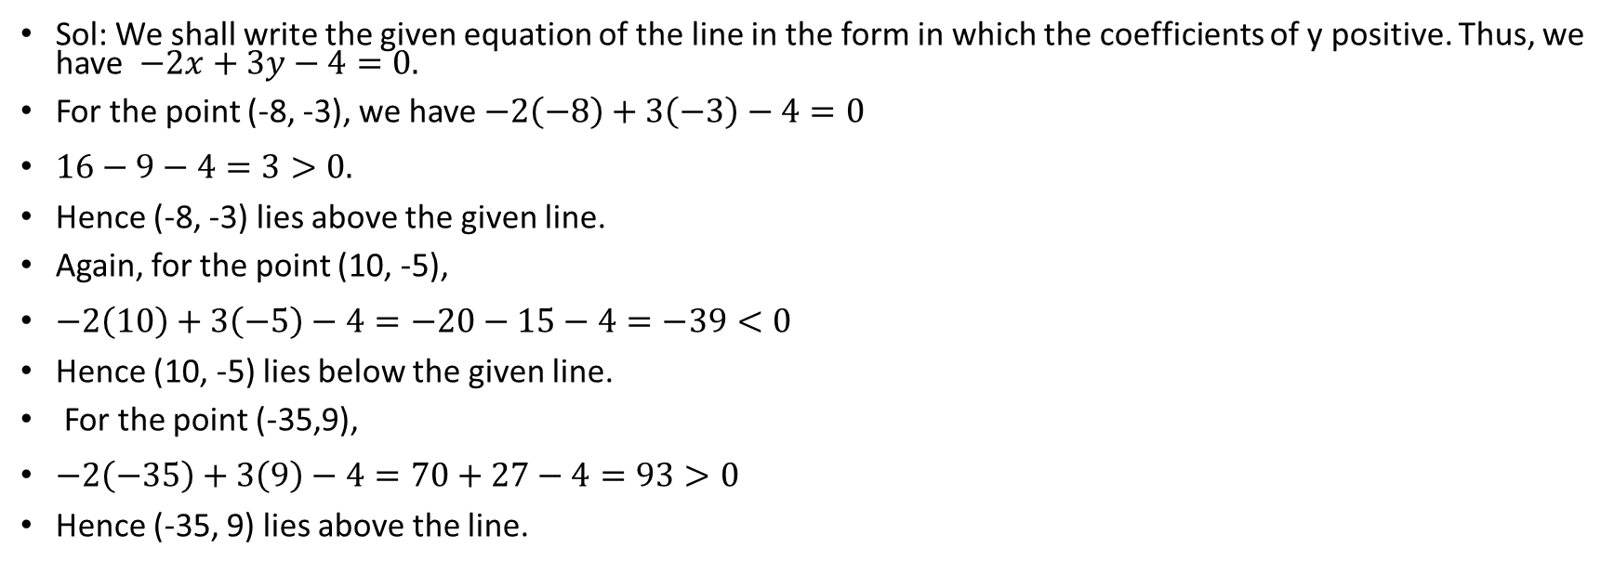
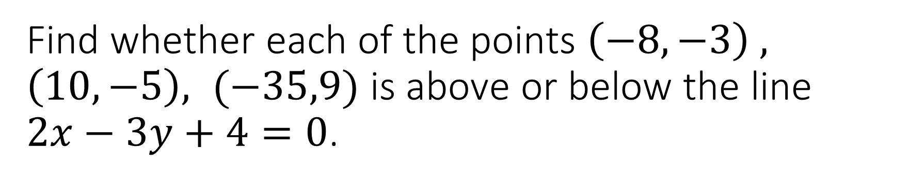
Find whether each of the points $\left(−8,−3\right) , \left(10, −5\right), (−35,9)$ is above or below the line $2x−3y+4=0$.
Sol: We shall write the given equation of the line in the form in which the coefficients of y positive. Thus, we have $−2x+3y−4=0.$
For the point (-8, -3), we have $−2\left(−8\right)+3\left(−3\right)−4=0$
$16−9−4=3>0.$
Hence (-8, -3) lies above the given line.
Again, for the point (10, -5),
$−2\left(10\right)+3\left(−5\right)−4=−20−15−4=−39<0$
Hence (10, -5) lies below the given line.
For the point (-35,9),
$−2\left(−35\right)+3\left(9\right)−4=70+27−4=93>0$
Hence (-35, 9) lies above the line.

Slide 5
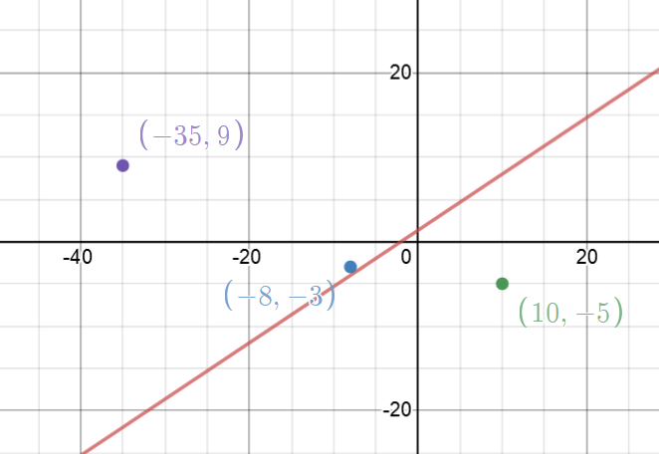

Slide 6
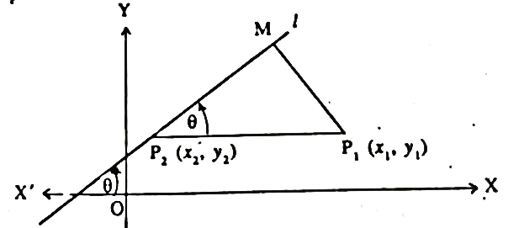

DISTANCE OF A POINT FROM A LINE
Let $l:ax+by+c=0$ be the given line making an angle $θ$with x-axis and $P_{1}\left(x_{1}, y_{1}\right)$ be the given point.
Let $\overline{P_{1}M}$be $⊥$ on the line $l$ and $\overline{P_{1}P_{2}}$ be parallel to x-axis cutting the line $l$ at $P_{2}\left(x_{2},y_{2}\right).$

Slide 7
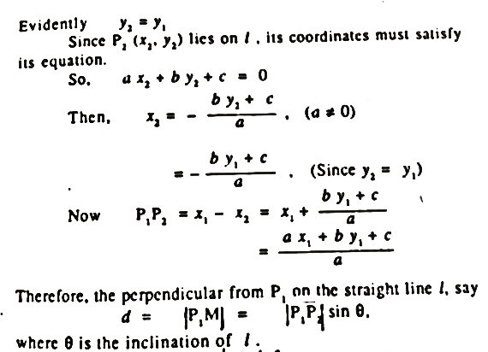

Slide 8
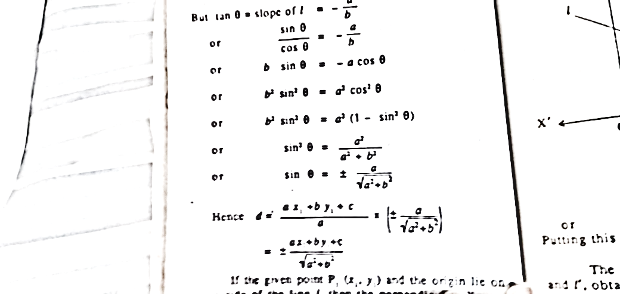

Slide 9
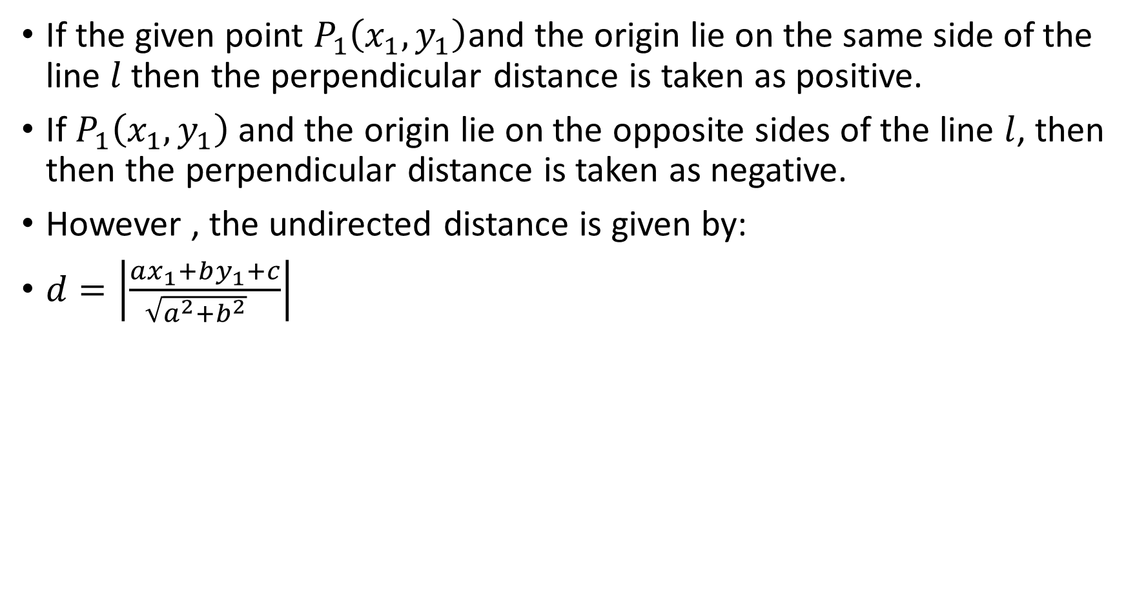
If the given point $P_{1}\left(x_{1}, y_{1}\right)$and the origin lie on the same side of the line $l$then the perpendicular distance is taken as positive.
If $P_{1}\left(x_{1}, y_{1}\right)$ and the origin lie on the opposite sides of the line $l$, then then the perpendicular distance is taken as negative.
However , the undirected distance is given by:
$d=\left|\frac{ax_{1}+by_{1}+c}{\sqrt{a^{2}+b^{2}} }\right|$

Slide 10
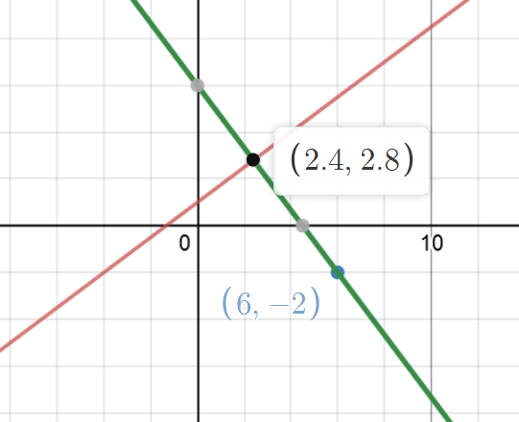
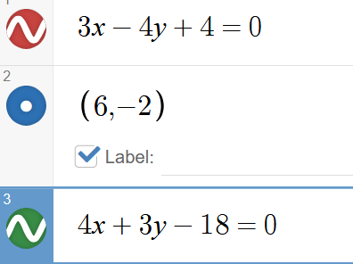

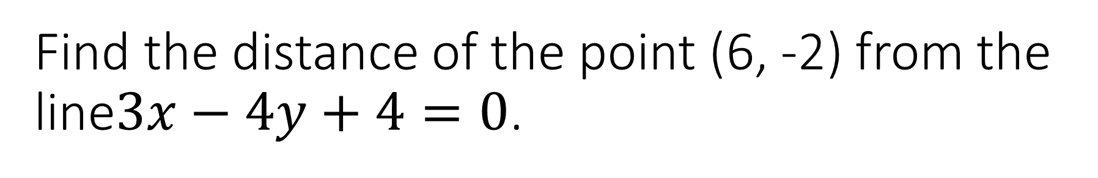
Find the distance of the point (6, -2) from the line$3x−4y+4=0$.
The undirected distance can be computed by
$d=\left|\frac{ax_{1}+by_{1}+c}{\sqrt{a^{2}+b^{2}}}\right|$=$\left|\frac{3\left(6\right)−4\left(−2\right)+4}{\sqrt{3^{2}+{\left(−4\right)}^{2}}}\right|$
$d=\frac{30}{5}=6 units$

Slide 11
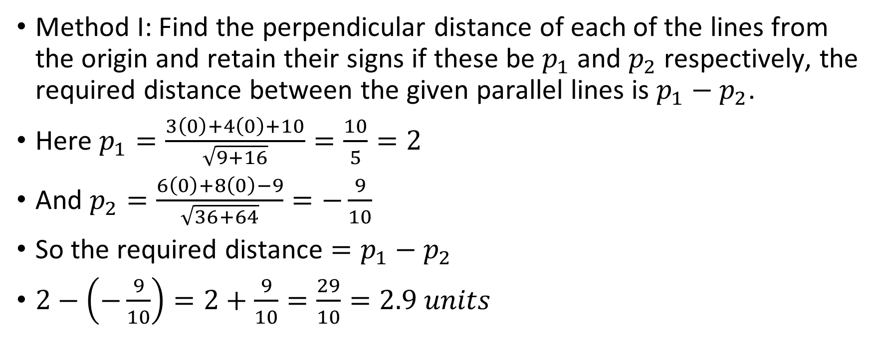
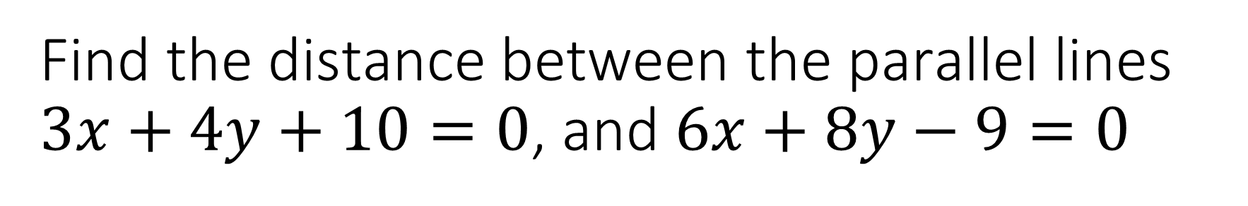
Find the distance between the parallel lines $3x+4y+10=0$, and $6x+8y−9=0$
Method I: Find the perpendicular distance of each of the lines from the origin and retain their signs if these be $p_{1}$ and $p_{2}$ respectively, the required distance between the given parallel lines is $p_{1}−p_{2}$.
Here $p_{1}=\frac{3\left(0\right)+4\left(0\right)+10}{\sqrt{9+16}}=\frac{10}{5}=2$
And $p_{2}=\frac{6\left(0\right)+8\left(0\right)−9}{\sqrt{36+64}}=−\frac{9}{10}$
So the required distance $=p_{1}−p_{2}$
$2−\left(−\frac{9}{10}\right)=2+\frac{9}{10}=\frac{29}{10}=2.9 units$

Slide 12
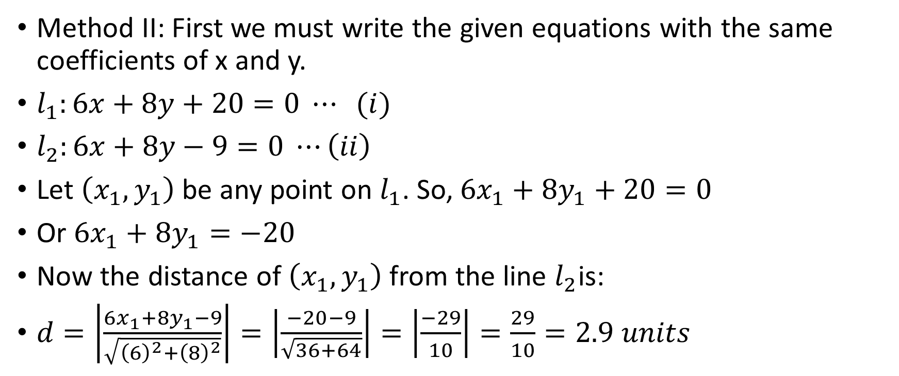
Find the distance between the parallel lines $3x+4y+10=0$, and $6x+8y−9=0$
Method II: First we must write the given equations with the same coefficients of x and y.
$l_{1}:6x+8y+20=0 ⋯ (i)$
$l_{2}:6x+8y−9=0 ⋯\left(ii\right)$
Let $\left(x_{1}, y_{1}\right)$ be any point on $l_{1}$. So, $6x_{1}+8y_{1}+20=0$
Or $6x_{1}+8y_{1}=−20$
Now the distance of $\left(x_{1}, y_{1}\right)$ from the line $l_{2}$is:
$d=\left|\frac{6x_{1}+8y_{1}−9}{\sqrt{{\left(6\right)}^{2}+{\left(8\right)}^{2}}}\right|=\left|\frac{−20−9}{\sqrt{36+64}}\right|=\left|\frac{−29}{10}\right|=\frac{29}{10}=2.9 units$

Slide 13
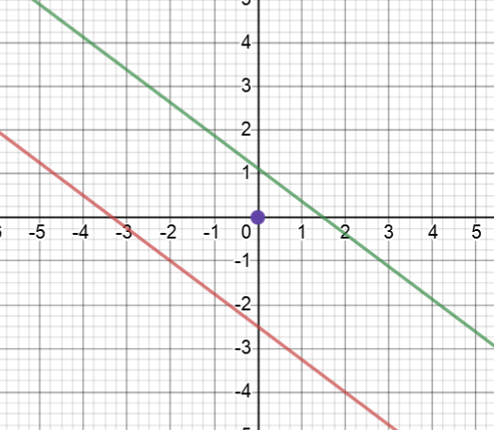
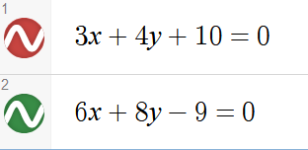

Slide 14
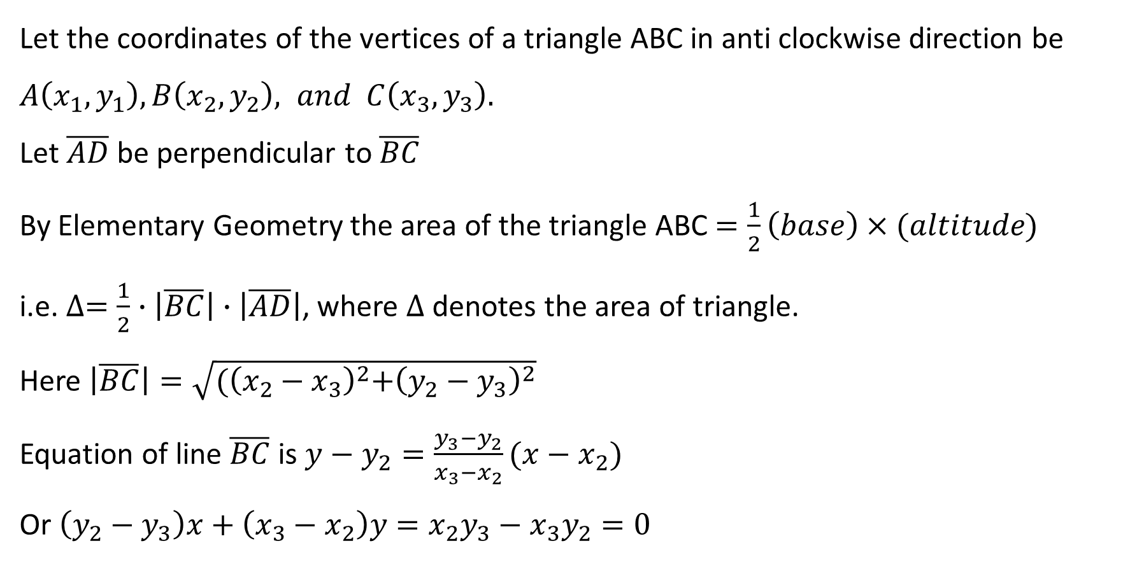
AREA OF A TRIANGLE
Let the coordinates of the vertices of a triangle ABC in anti clockwise direction be $A\left(x_{1},y_{1}\right), B\left(x_{2},y_{2}\right), and C\left(x_{3},y_{3}\right).$
Let $\overline{AD}$ be perpendicular to $\overline{BC}$
By Elementary Geometry the area of the triangle ABC $=\frac{1}{2}\left(base\right)×(altitude)$
i.e. $∆=\frac{1}{2}∙\left|\overline{BC}\right|∙\left|\overline{AD}\right|$, where $∆$denotes the area of triangle.
Here $\left|\overline{BC}\right|=\sqrt{{(\left(x_{2}−x_{3}\right)}^{2}+{\left(y_{2}−y_{3}\right)}^{2}}$
Equation of line $\overline{BC}$ is $y−y_{2}=\frac{y_{3}−y_{2}}{x_{3}−x_{2}}(x−x_{2})$
Or $\left(y_{2}−y_{3}\right)x+\left(x_{3}−x_{2}\right)y=x_{2}y_{3}−x_{3}y_{2}=0$

Slide 15
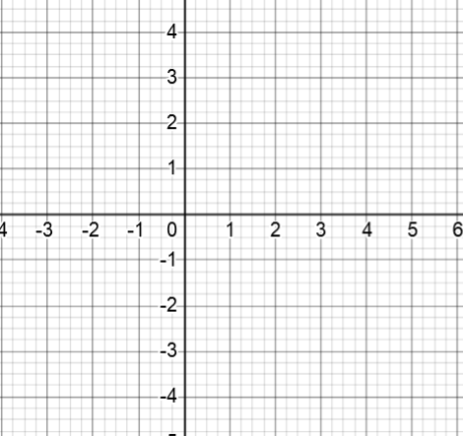




$$A(x_{1},y_{1})$$
B$(x_{2},y_{2})$
$$D$$
C$(x_{3},y_{3})$

Slide 16
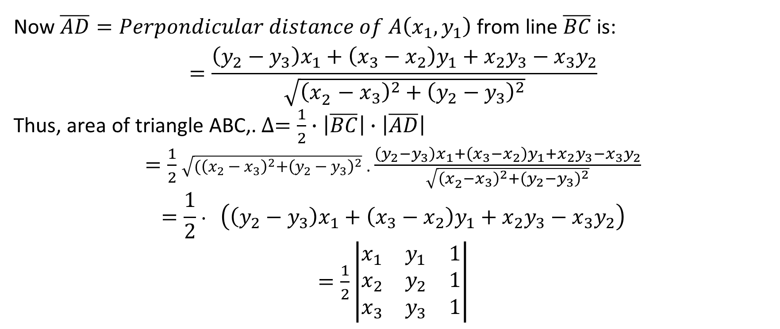
AREA OF A TRIANGLE
Now $\overline{AD}=Perpondicular distance of A\left(x_{1},y_{1}\right)$ from line $\overline{BC}$ is:
$$=\frac{\left(y_{2}−y_{3}\right)x_{1}+\left(x_{3}−x_{2}\right)y_{1}+x_{2}y_{3}−x_{3}y_{2}}{\sqrt{{\left(x_{2}^{ }−x_{3}\right)}^{2}+{\left(y_{2}−y_{3}\right)}^{2}}}$$
Thus, area of triangle ABC,. $∆=\frac{1}{2}∙\left|\overline{BC}\right|∙\left|\overline{AD}\right|$
$=\frac{1}{2}$ $\sqrt{{(\left(x_{2}−x_{3}\right)}^{2}+{\left(y_{2}−y_{3}\right)}^{2}}$ . $\frac{\left(y_{2}−y_{3}\right)x_{1}+\left(x_{3}−x_{2}\right)y_{1}+x_{2}y_{3}−x_{3}y_{2}}{\sqrt{{\left(x_{2}^{ }−x_{3}\right)}^{2}+{\left(y_{2}−y_{3}\right)}^{2}}}$
$$=\frac{1}{2}∙ \left(\left(y_{2}−y_{3}\right)x_{1}+\left(x_{3}−x_{2}\right)y_{1}+x_{2}y_{3}−x_{3}y_{2}\right)$$ $=\frac{1}{2}\left|\begin{matrix}x_{1} & y_{1} & 1 \\ x_{2} & y_{2} & 1 \\ x_{3} & y_{3} & 1\end{matrix}\right|$

Slide 17
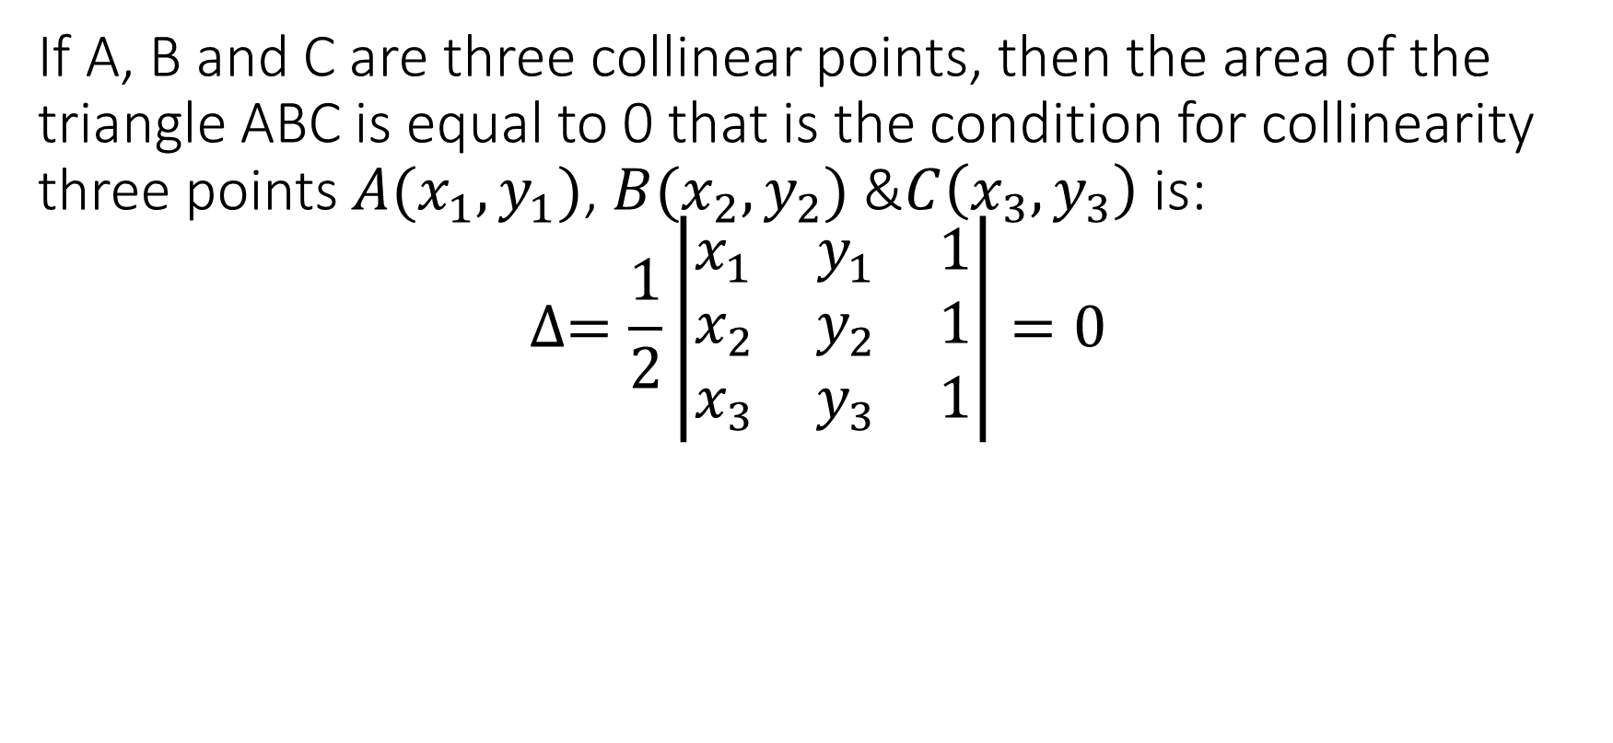
If A, B and C are three collinear points, then the area of the triangle ABC is equal to 0 that is the condition for collinearity three points $A(x_{1}, y_{1})$, $B(x_{2},y_{2})$ &$C\left(x_{3}, y_{3}\right)$ is: $$∆=\frac{1}{2}\left|\begin{matrix}x_{1} & y_{1} & 1 \\ x_{2} & y_{2} & 1 \\ x_{3} & y_{3} & 1\end{matrix}\right|=0$$

